Slide 1
App Presentation
By 200
Chen Qin, Weiru He, Shang Lyu, Zeyu Su, Chien-Ying Yang

Slide 2





Favorite App
A social media app that allows user to share short videos.
It has a very good algorithm to allow every user has a personalized watching experience and it allows inherits some basic video making tools.
A multi-purpose app that allows user to do what paypal, instagram, whatsapp can do.
The one-stop-shop experience eliminates the need for multiple apps since it has features like mobile payment, ticket booking, messaging and etc.
A social media app that allows user to share videos, photos and their thought of that time.
It emphasize on high-quality photos and videos and has built-in easy-to-use photo editing tools.
An online shopping app that allows user to buy a great amount of selection from groceries to electronics with just a click on finger.
The same online shopping experience as the website allows the users to buy whatever they want with just a click on the phone instead of find a laptop or browsing the web page on a tiny screen of a phone.
A ride-hailing app that connects passengers with nearby drivers.
The convenience in terms of requesting a ride and related experience it provides makes it so popular.

Slide 3
App ideas
A catalog app for collector to archive their collection digitally, more specifically, for nintendo switch collectors. So that they don’t buy extra and able to access their collection catalog anywhere within their mobile device.
An app for automatic cost-sharing. When traveling with multiple people you can keep track of who paid how much and how the costs should be shared equally. This app should also have the ability to switch currencies, record time, etc.
An app to trace film developing. Since nowadays a bag of chemicals for film development can develop about 10-15 rolls of film, but manually tracing it could be difficult and time consuming. This app allows the user to keep track of the rolls of film developed for each batch of film and how each rolls of film turns out using the built-in catalog system.

Slide 4
What is good already?
What could it do better?
A complete shopping experience
Wide-range selection of product
Fast delivery service
The arrangement of a product page
The efforts to report a missing package from a third party product
A contact page for direct communication between buyer and seller as well as checking previous record
The lack of choice of what product can be paid in the cart page.

Slide 5
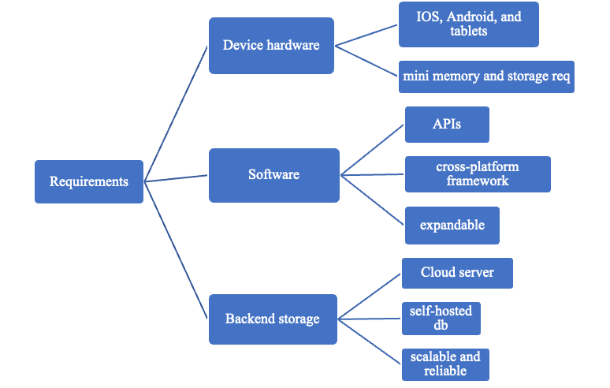
Design Challenge — Contractor for you
Considerations
UI Design
Platform
Profile
Geolocation
Rating and review
Recommendation
Live chat
Notes:
1. UI design: We need to design a user-friendly interface. Users could choose to switch to a simple version (e.g. larger fonts and clearer icons). It is a version designed for elderly users.
2. Platform types: The app should support both android and ios platform.
3.Both users and contractors have their profile pages. Users can show what they want and contractors can show what they can do.
4.Geolocation technology will be used to allow users find contractors nearby. This information will also be shown on the profile.
5.The application should allow both contractors and users to rate and review each other. They have a chance to choose to work with highly rated and well-reviewed people.
6.Recommendation: When users or contractors open the app, the system will push the most suitable contractor or user to them precisely based on the information on their profile.
7. The app should provide a platform for users and contractors to chat online. Users can send messaged directly to contractors, but contractors cannot send message directly to users. If a contractor wants to reach out to a user, they need to send their profile to the user first. Only when the user agrees can they send a message and start chatting.
Requirements:
Device:
compatible with both ios and android. It is an improvement that the app is available on tablets.
The app should have minimum memory and storage requirements that are consistent with industry standards for the respective platforms.
Software:
APIs are needed to implement the functions of the app.
Cross-platform framework: The app should be built using a cross-platform framework .
The application should be expandable to satisfy future requirements.
Backend storage:
The application will use a cloud server (AWS) to store application data and files.
A self-hosted database (MongoDB or MySQL) is needed to store privacy information related to the contractors and users.
The back-end storage of the app should be scalable to handle the increasing number of data and reliable to protect user data.

Slide 6
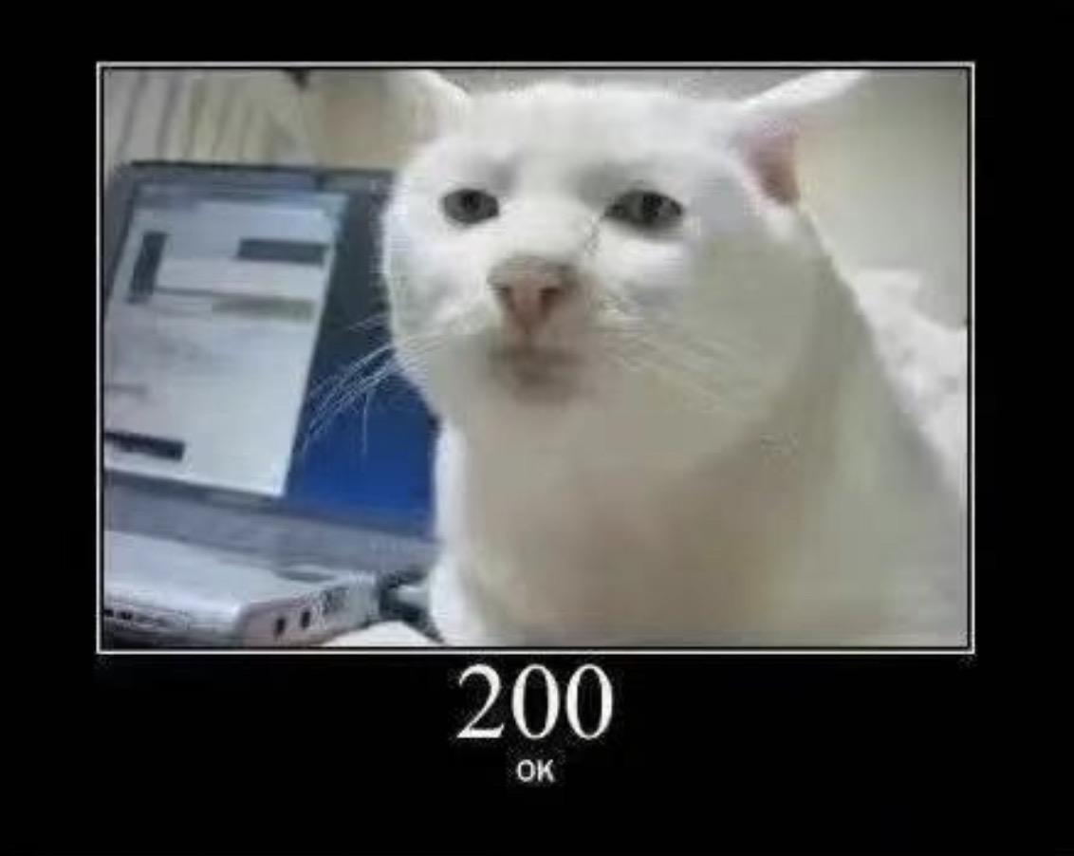
Thanks!

